Slide 1
BITS Pilani

Slide 2
LL(1) Parser

Slide 3
Exercise 1
Consider the following grammar and answer questions i-iii.
S -> (L) | a
L -> L,S | S
You are asked to implement a RDP, what problem do you encounter and why?
What transformation is required to make it parsable by RDP?
After the transformation show how you implement function S using RDP. [note: you need not show functions for main, match and L]

Slide 4
Exercise 1 (Contd..)

Slide 5
Exercise 1 (Contd..)

Slide 6
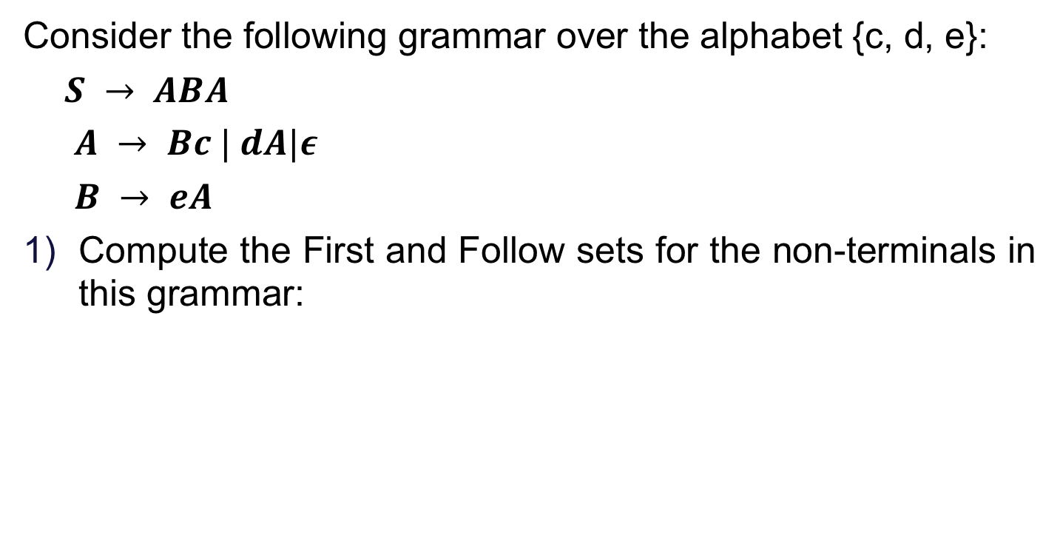
Exercise 2
Consider the following grammar over the alphabet {c, d, e}:
$S → ABA$
$A → Bc | dA|ε$
$B → eA$
Compute the First and Follow sets for the non-terminals in this grammar:

Slide 8
 | First | Follow
S | d, e | $
A | ϵ, d, e | e, $, c, d
B | e | c, d, e, $

Slide 9
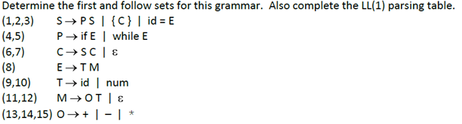
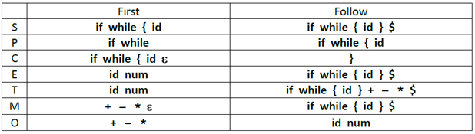
Exercise 2

Slide 10
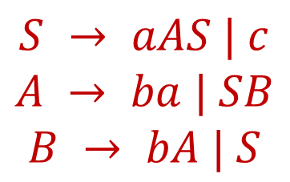
Recursive descent parser – Example
$$S → aAS | c$$
$$A → ba | SB$$
$$B → bA | S$$

Slide 11
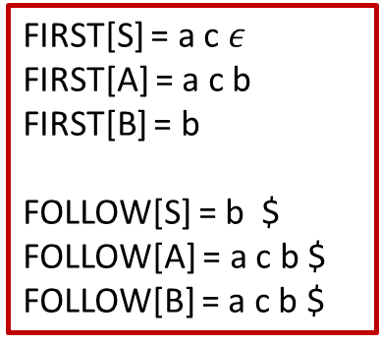
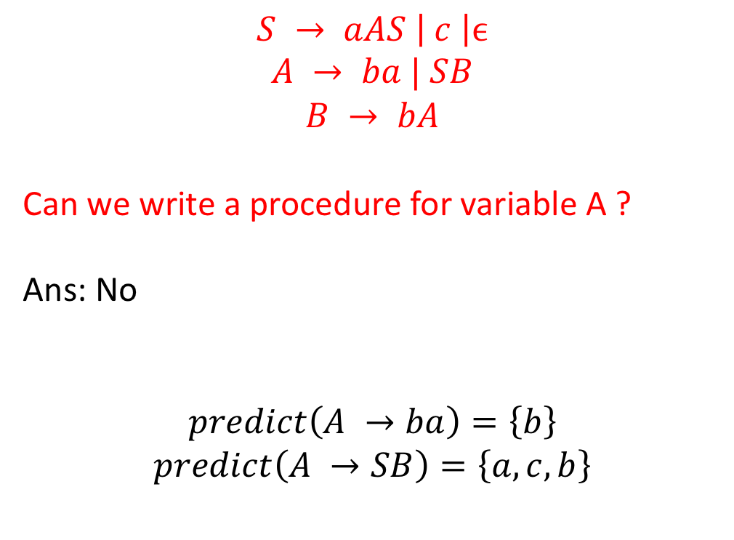
Recursive descent parser – Example
$$S → aAS \left| c \right|ϵ$$
$$A → ba | SB$$
$$B → bA$$
Can we write a procedure for variable A ?
Ans: No
$$predict\left(A →ba\right)=\left\{b\right\}$$
$$predict\left(A →SB\right)=\left\{a, c, b\right\}$$
FIRST[S] = a c $ε$
FIRST[A] = a c b
FIRST[B] = b
FOLLOW[S] = b $
FOLLOW[A] = a c b $
FOLLOW[B] = a c b $

